Slide 1
Patrick Mathias
DLMP Core

Slide 2
Lesson Goals
Compare and contrast different data types (e.g., numerical, categorical, timestamp, logical) used in data analytics
Conduct basic exploratory data analysis to evaluate data quality or assumptions and summarize using quantitative, qualitative, univariate, and multivariate methods
Lesson Objectives
Use a function to perform an operation on data
Define and create objects in the environment
Install and load packages
Import data from a file into the R environment
Inspect the contents of a dataframe
Notes:
In the second session we will learn some fundamentals of coding including using functions, creating objects, and importing data.

Slide 4
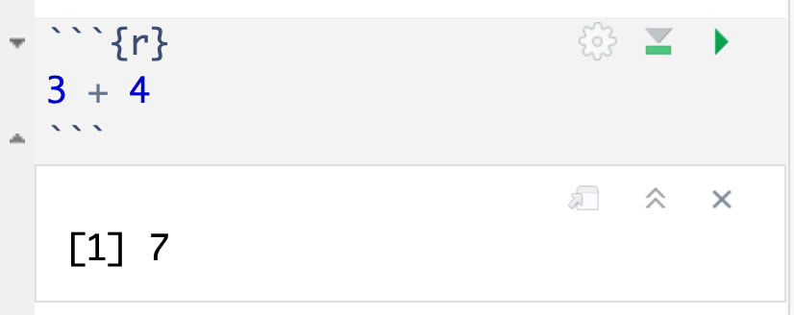
press play button to execute code
R is a calculator!
answer returned below
Notes:
At it’s most basic, R is a fancy calculator.
It supports common mathematical operators
+ add, - subtract
* multiply, / divide
^ exponents
When we execute our code by pressing the play button, the answer is returned below the code chunk.

Slide 5
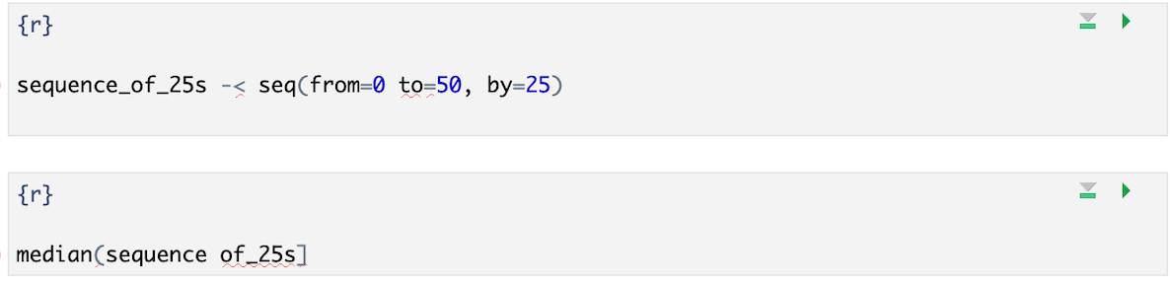
Your Turn #1
I’ve written some code to create a sequence from 0 to 500 in increments of 25 called sequence_of_25s. Ultimately I want to calculate the median value of this sequence. Unfortunately I’ve made some mistakes in my code and I am hoping you can help me find them.
Notes:
We will meet back together in a minute to see if we can fix this code together.
Hint: There are a total of 5 mistakes.

